Slide 1
Welcome to the Web Application Development with Python L-4 Training Program

Slide 2
MD. SHAKIL
NSDA Certified Trainer & Assessor
Vendor Certified
IT Specialist in Python
Sr. Backend Developer
Ethical Den
Asst. Trainer
Daffodil International Professional Training Institute
Lead Trainer
eShikhon IT Training Institute
Lead Trainer
Wizard Software & Technology
+88 01793-299882
shakil.eub.cse@gmail.com
https://www.linkedin.com/in/mrshakil015
https://mrshakil.com

Slide 3
Python Dictionary
Lecture
09

Slide 4
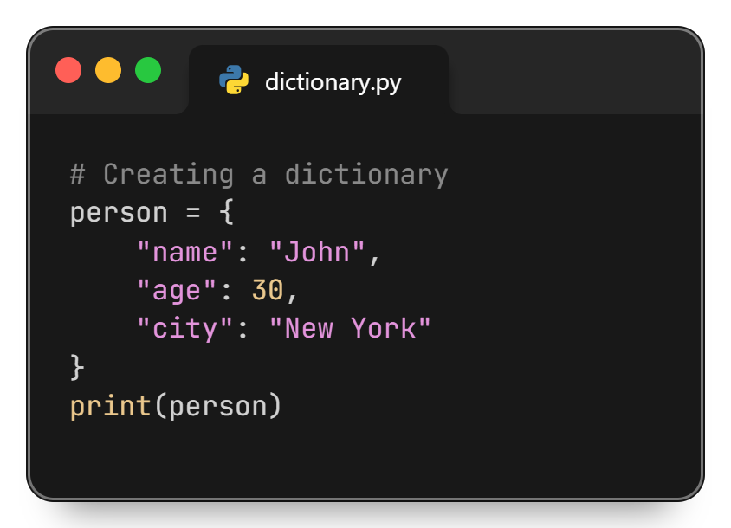
Python Dictionary
A dictionary in Python is a collection of data stored in key–value pairs. Dictionaries are unordered, mutable (changeable), and do not allow duplicate keys. They are widely used to represent real-world data.

Slide 5
Why Use Dictionaries?
Dictionaries are used to:
Store data with meaningful keys
Access values quickly using keys
Represent structured data (e.g., student, product, user)
Map relationships between data

Slide 6
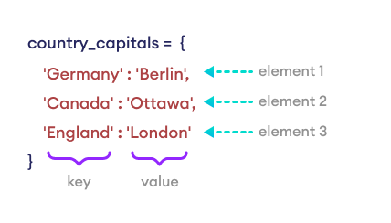
Creating a Dictionary
Dictionaries are created using curly braces { } with key–value pairs separated by a colon(:)

Slide 7
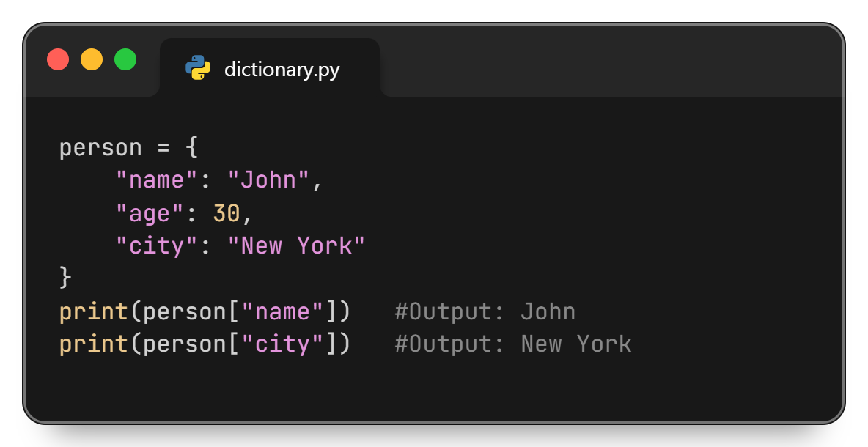
Access Dictionary Elements by Key

Slide 8
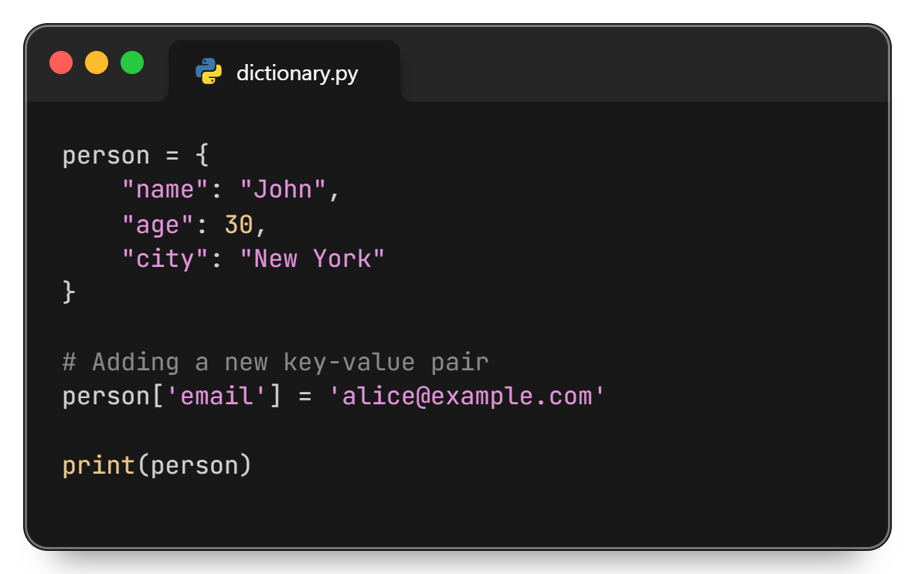
Adding Items

Slide 9
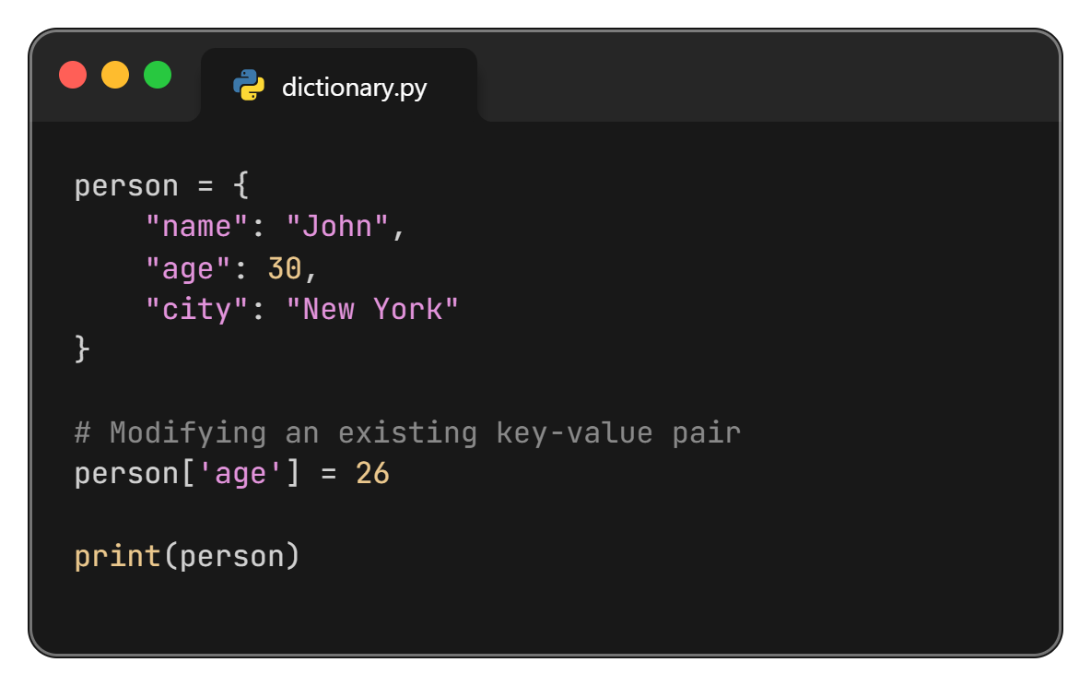
Modifying Items

Slide 10
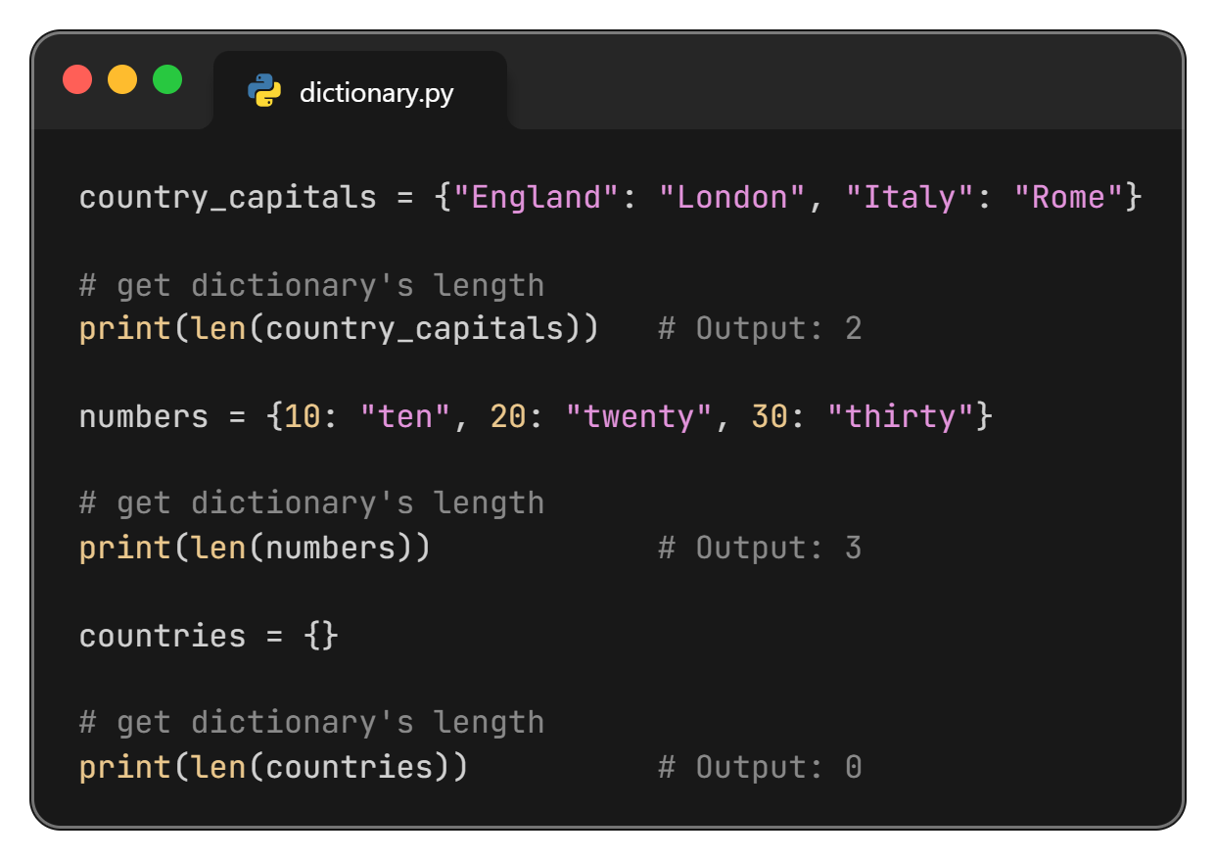
Find Dictionary Length

Slide 11
Removing Dictionary Items

Slide 12
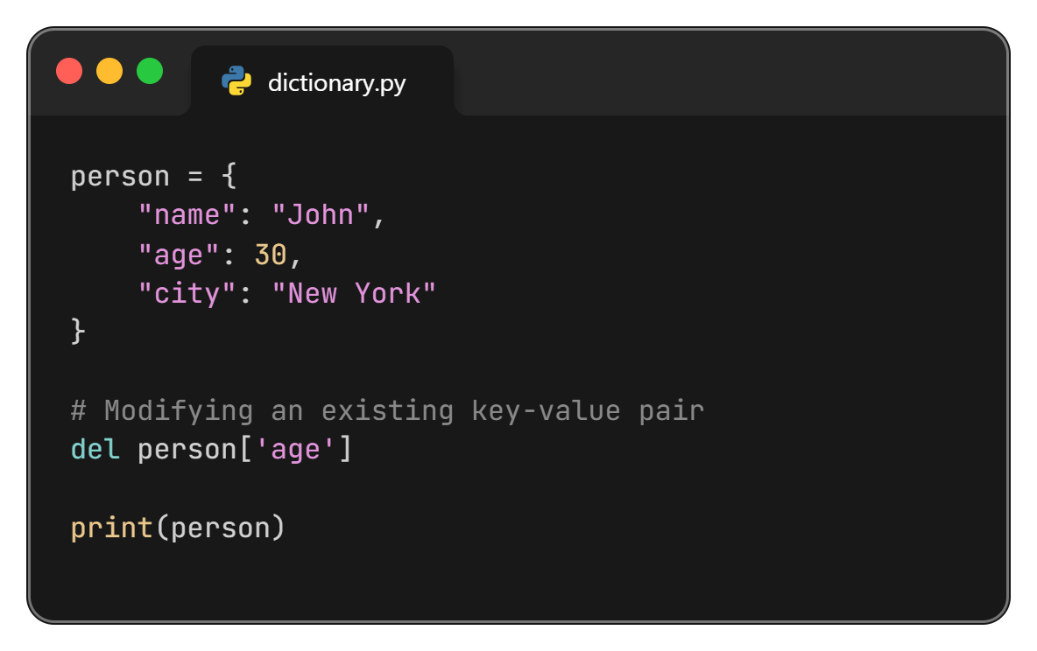
Remove Dictionary Items

Slide 13
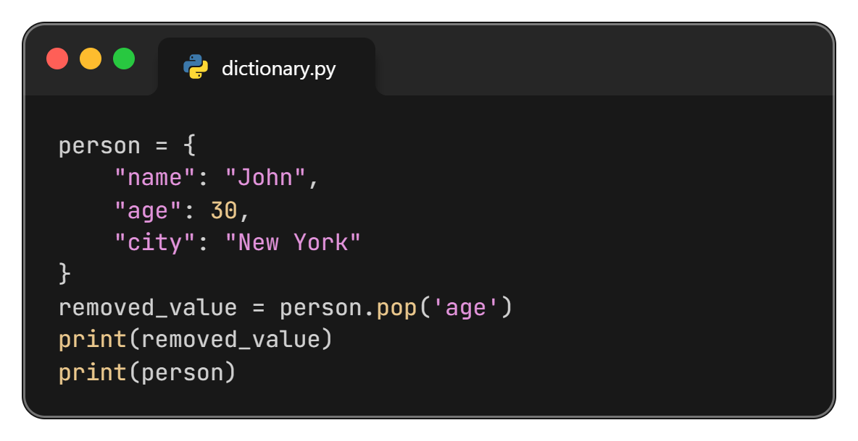
pop() Method in Dictionary
Removes and returns the value associated with the specified key. If the key is not found, it raises a KeyError unless a default value is provided.

Slide 14
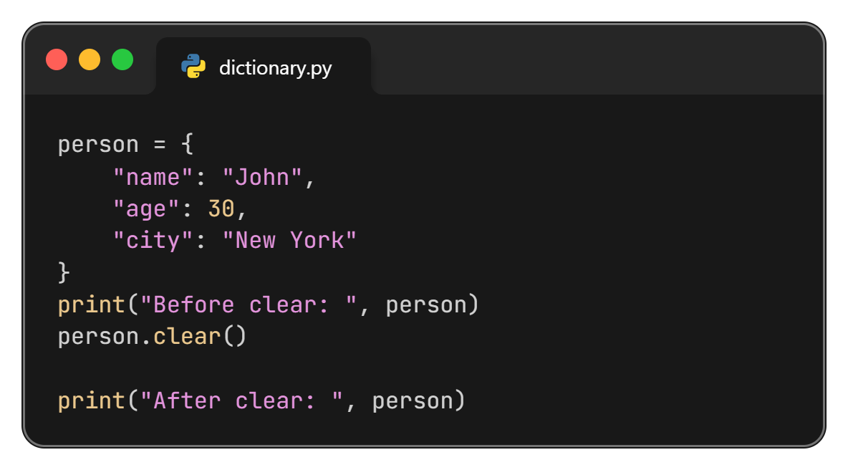
clear() Method in Dictionary
Removes all items from the dictionary.

Slide 15
Method in Dictionary

Slide 16
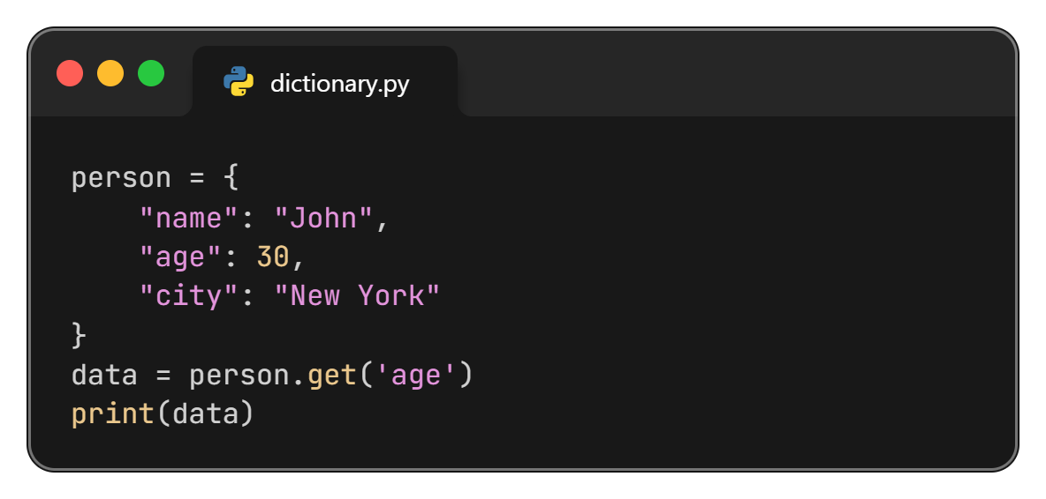
get() Method in Dictionary
Returns the value for a given key. If the key is not found, it returns None.

Slide 17
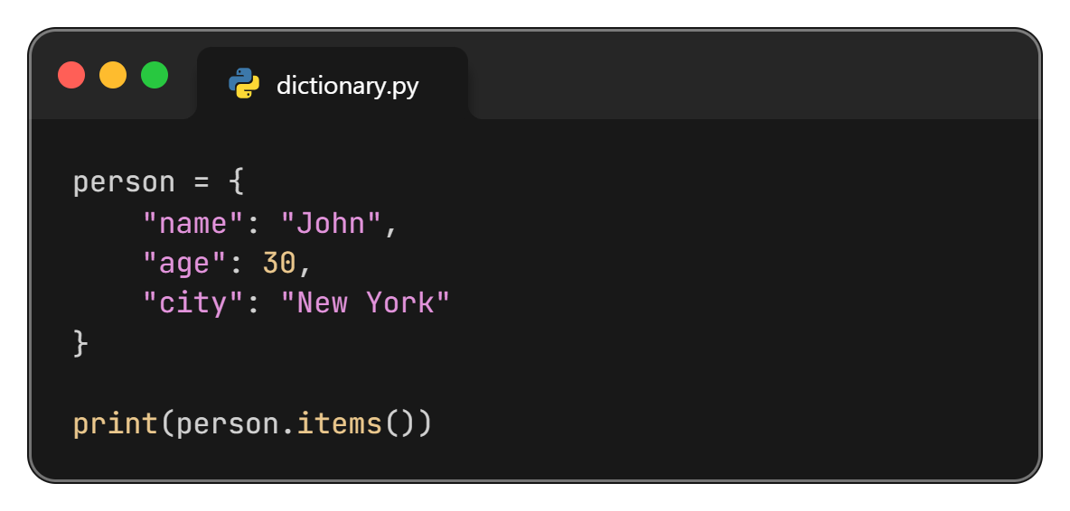
items() Method in Dictionary
Returns a view object that displays a list of dictionary’s key-value tuple pairs.

Slide 18
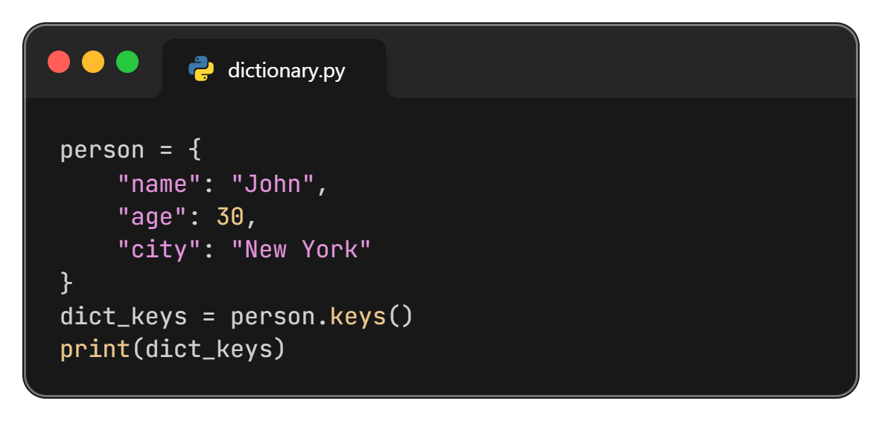
keys() Method in Dictionary
Returns a view object that displays a list of all the keys in the dictionary.

Slide 19
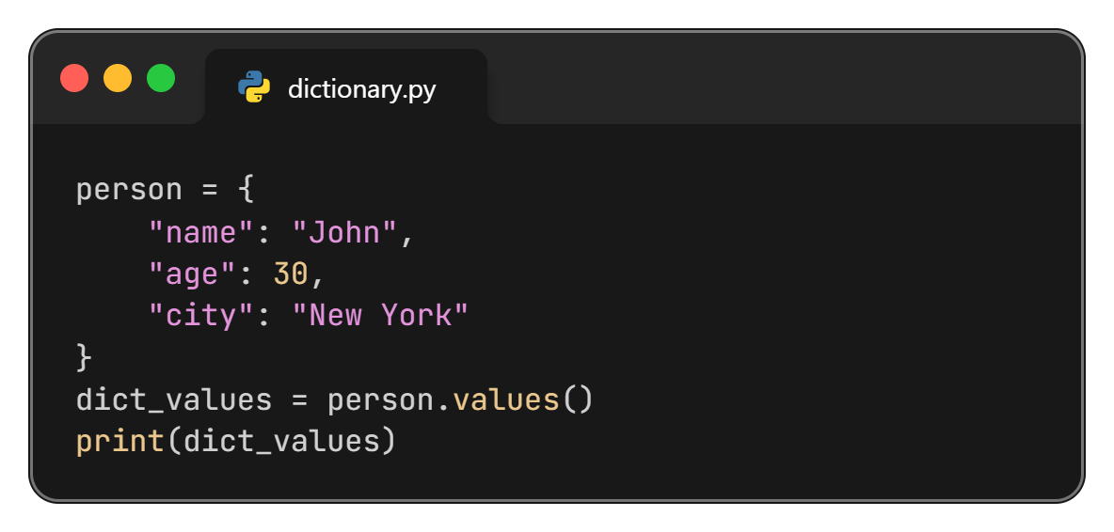
values() Method in Dictionary
Returns the values in the dictionary.

Slide 20
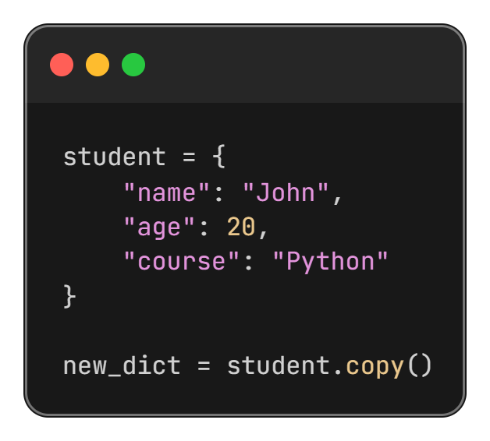
copy() Method in Dictionary
Returns a copy of the specified dictionary.

Slide 21
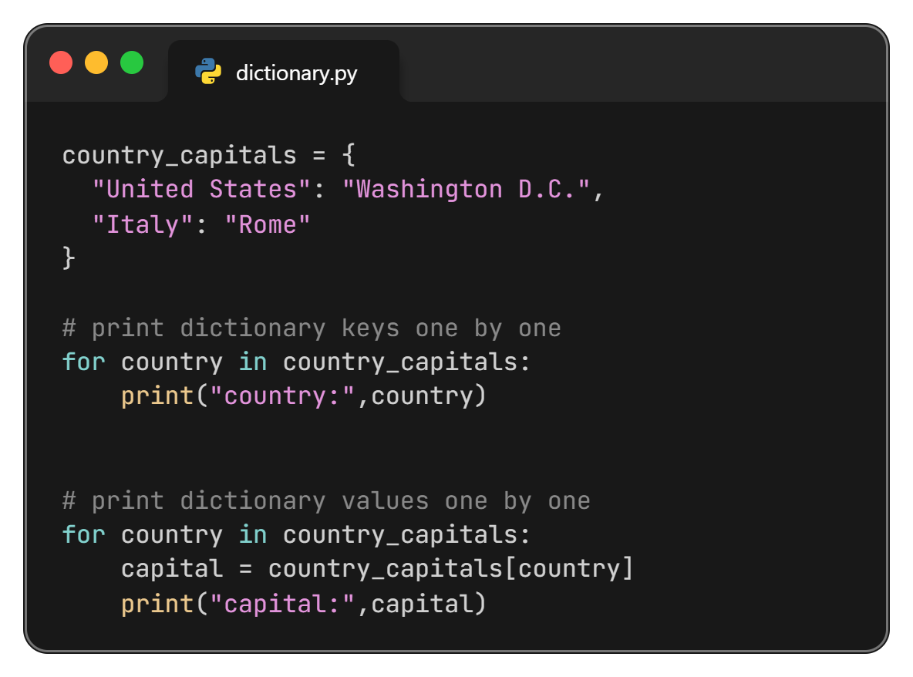
Iterate Through a Dictionary

Slide 22
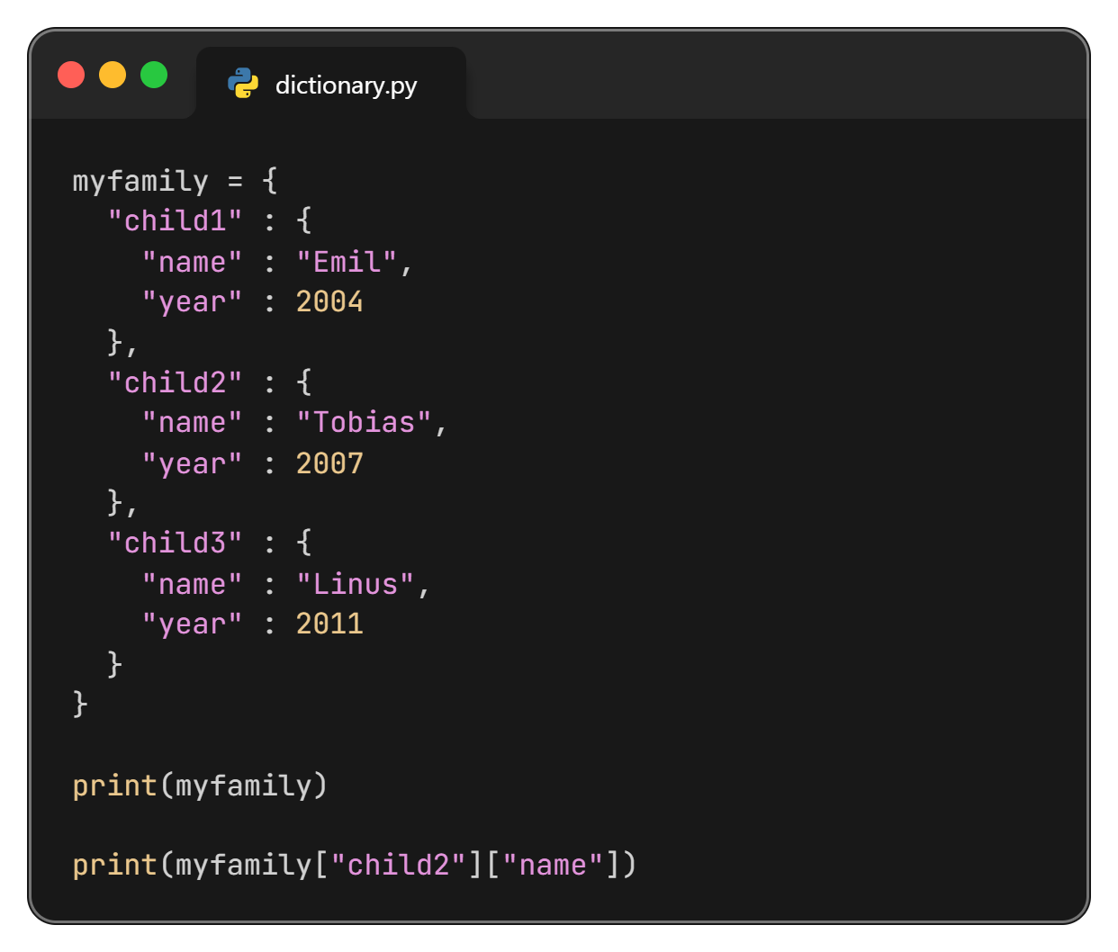
Nested Dictionary

Slide 23
Thanks All

